Slide 1
Industry Tech Stack & Trends

Slide 2
Tech Stack – ML Perspective
Git – Version control system
Incident Management/ Project Tracking – Jira, Azure Devops etc..
IDE – VSCode, Jupyter Lab, PyCharm, Visual Studio
Anaconda/PIP – Package management
ML/DL Platforms – Pytorch, TensorFlow, Scikit-Learn, Keras, ONNX (Runtime), ML.Net, Turi
Docker - Docker is an open platform for developing, shipping, and running applications. It enables you to separate your applications from your infrastructure so you can deliver software quickly.
Docker provides the ability to package and run an application in a loosely isolated environment called a container. The isolation and security allows you to run many containers simultaneously on a given host.
Containers are lightweight and contain everything needed to run the application, so you do not need to rely on what is currently installed on the host
Kubernetes is an open-source Container Management tool which automates container deployment, container scaling, and descaling and container load balancing (also called as container orchestration tool)
GPU/CUDA
Cloud Computing
Distributed Computing

Slide 3

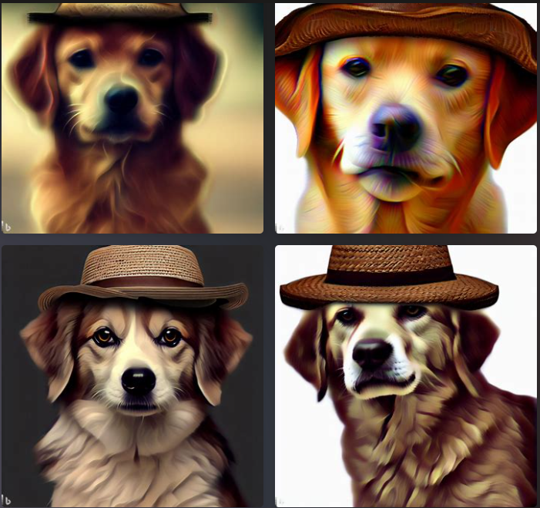
Industry Trends
Transformer Models
LLMs, Multilingual LLMs
GPT, ChatGPT
OpenAI, HuggingFace
Fine-tuning LLMs
Transfer Learning
DALL.E - Image Creator from Microsoft Bing

